Slide 1
Chapter Twenty-two
Exchange
交换

Slide 2
Contents
The Edgeworth (艾奇沃斯) Box
Pareto improving trade
Pareto Efficient Allocation
The Core (核心)
Trade in a competitive market
Walras’ Law of general equilibrium (一般均衡)
First Fundamental Theorem of Welfare Economics (福利经济学第一定理)
Second Fundamental Theorem of Welfare Economics (福利经济学第二定理)

Slide 3
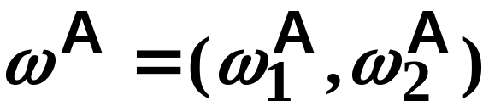
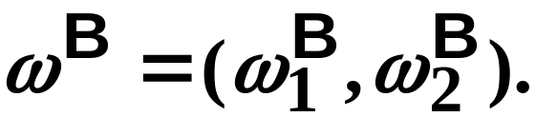
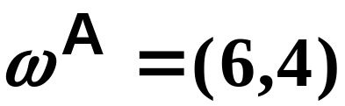
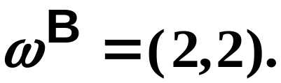
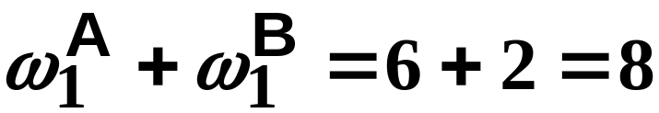
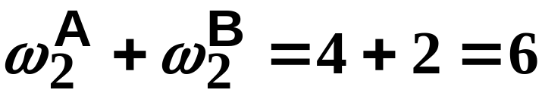
Exchange
Two consumers, A and B.
Their endowments of goods 1 and 2 are
E.g.
The total quantities available
and
and
are
units of good 1
and
units of good 2.

Slide 4
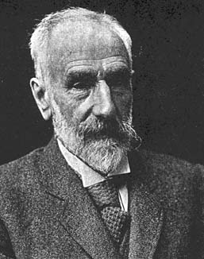
Exchange
Edgeworth and Bowley devised a diagram, called an Edgeworth box, to show all possible allocations of the available quantities of goods 1 and 2 between the two consumers.
1845-1926

Slide 5
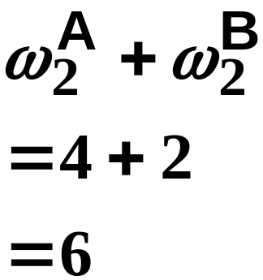
Starting an Edgeworth Box
Height =
The dimensions of
the box are the
quantities available
of the goods.
Width =

Slide 6
Feasible Allocations
What allocations of the 8 units of good 1 and the 6 units of good 2 are feasible?
How can all of the feasible allocations be depicted by the Edgeworth box diagram?
One feasible allocation is the before-trade allocation; i.e. the endowment allocation.

Slide 7
The Endowment Allocation
Height =
The endowment
allocation is
and
Width =

Slide 8
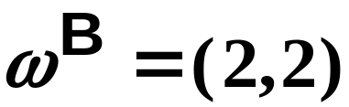
The Endowment Allocation
Height =
Width =

Slide 9
The Endowment Allocation
O_{B}
6
O_{A}
8

Slide 10
The Endowment Allocation
O_{B}
6
4
O_{A}
6
8

Slide 11
The Endowment Allocation
2
O_{B}
2
6
4
O_{A}
6
8

Slide 12
The Endowment Allocation
2
O_{B}
2
6
The
endowment
allocation
4
O_{A}
6
8

Slide 13
The Endowment Allocation
More generally, …

Slide 14
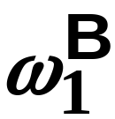
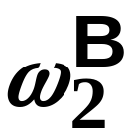
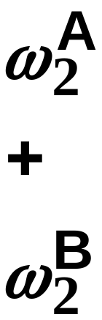
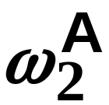
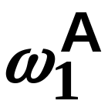
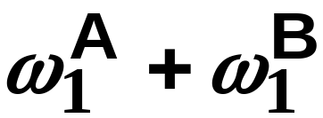
The Endowment Allocation
O_{B}
The
endowment
allocation
O_{A}

Slide 15
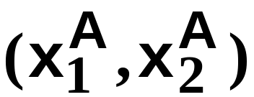
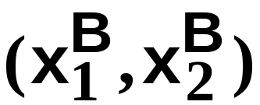
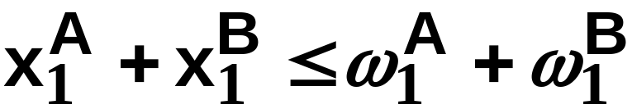
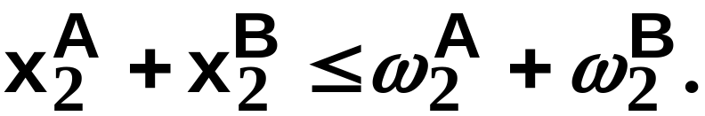
Other Feasible Allocations
denotes an allocation to consumer A.
denotes an allocation to consumer B.
An allocation is feasible if and only if
and

Slide 16
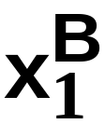
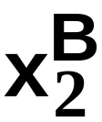
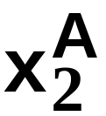
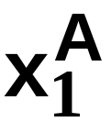
Feasible Reallocations
O_{B}
O_{A}

Slide 17
Feasible Reallocations
O_{B}
O_{A}

Slide 18
Feasible Reallocations
All points in the box, including the boundary, represent feasible allocations of the combined endowments.
Which allocations make both consumers better off?

Slide 19

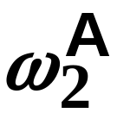
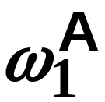

Adding Preferences to the Box
For consumer A.
O_{A}

Slide 20
Adding Preferences to the Box
For consumer A.
More preferred
O_{A}

Slide 21


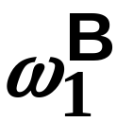
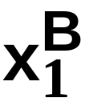
Adding Preferences to the Box
For consumer B.
O_{B}

Slide 22
Adding Preferences to the Box
For consumer B.
More preferred
O_{B}

Slide 23
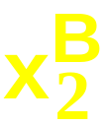
Adding Preferences to the Box
For consumer B.
O_{B}
More preferred

Slide 24
Adding Preferences to the Box
For consumer A.
O_{A}

Slide 25
Adding Preferences to the Box
O_{B}
O_{A}

Slide 26
Edgeworth’s Box
O_{B}
O_{A}

Slide 27
Pareto-Improvement
An allocation of the endowment that improves the welfare of a consumer without reducing the welfare of another is a Pareto-improving allocation.
Where are the Pareto-improving allocations?

Slide 28
Edgeworth’s Box
O_{B}
O_{A}

Slide 29
Pareto-Improvements
O_{B}
O_{A}
The set of Pareto-
improving allocations

Slide 30
Pareto-Improvements
Since each consumer can refuse to trade, the only possible outcomes from exchange are Pareto-improving allocations.
But which particular Pareto-improving allocation will be the outcome of trade?

Slide 31
Pareto-Improvements
O_{B}
O_{A}
The set of Pareto-
improving reallocations

Slide 32
Pareto-Improvements

Slide 33
Pareto-Improvements

Slide 34
Pareto-Improvements
Trade
improves both
A’s and B’s welfares.
This is a Pareto-improvement
over the endowment allocation.

Slide 35
Pareto-Improvements
New mutual gains-to-trade region
is the set of all further Pareto-
improving
reallocations.
Trade
improves both
A’s and B’s welfares.
This is a Pareto-improvement
(帕累托改进)over the endowment allocation.

Slide 36
Pareto-Improvements
Further trade cannot improve
both A and B’s
welfares.

Slide 37
Pareto-Optimality (帕累托最优)
Better for
consumer A
Better for
consumer B

Slide 38
Pareto-Optimality
A is strictly better off
but B is strictly worse
off
B is strictly better
off but A is strictly
worse off

Slide 39
Pareto-Optimality
Both A and
B are worse
off
A is strictly better off
but B is strictly worse
off
B is strictly better
off but A is strictly
worse off
Both A
and B are
worse
off

Slide 40
Pareto-Optimality
The allocation is
Pareto-optimal since the
only way one consumer’s
welfare can be increased is to
decrease the welfare of the other
consumer.

Slide 41
Pareto-Optimality
The Marginal Rates of
Substitution Are Equal.
The allocation is
Pareto-optimal since the
only way one consumer’s
welfare can be increased is to
decrease the welfare of the other
consumer.

Slide 42
Pareto-Optimality
Where are all of the Pareto-optimal allocations of the endowment?

Slide 43
Pareto-Optimality
O_{B}
O_{A}

Slide 44
Pareto-Optimality
All the allocations marked by
a are Pareto-optimal.
O_{B}
O_{A}

Slide 45
Pareto-Optimality
The contract curve (契约线) is the set of all Pareto-optimal allocations.

Slide 46
Pareto-Optimality
All the allocations marked by
a are Pareto-optimal.
O_{B}
O_{A}
The contract curve

Slide 47
Pareto-Optimality
But to which of the many allocations on the contract curve will consumers trade?

Slide 48
The Core (核心)
O_{B}
O_{A}
The set of Pareto-
improving reallocations

Slide 49
The Core
O_{B}
O_{A}

Slide 50
The Core
Pareto-optimal trades blocked
by B
O_{B}
O_{A}
Pareto-optimal trades blocked
by A

Slide 51
The Core
Pareto-optimal trades not blocked
by A or B are the core.
O_{B}
O_{A}

Slide 52
The Core
The core is the set of all Pareto-optimal allocations that are welfare-improving for both consumers relative to their own endowments.
Rational trade should achieve a core allocation.

Slide 53
The Core
But which core allocation?
That depends upon the manner in which trade is conducted.

Slide 54
Trade in Competitive Markets
Consider trade in perfectly competitive markets.
Each consumer is a price-taker trying to maximize her own utility given p₁, p₂ and her own endowment. That is, ...

Slide 55
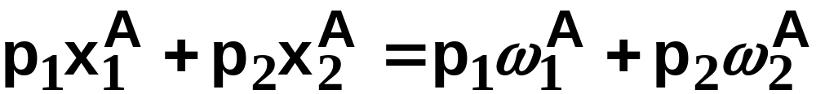
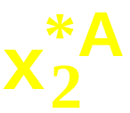
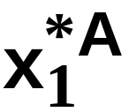
Trade in Competitive Markets
For consumer A.
O_{A}

Slide 56
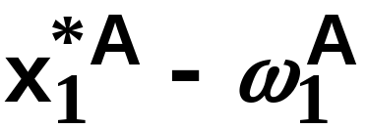
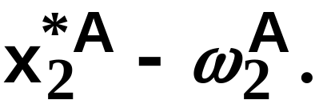
Trade in Competitive Markets
So given p₁ and p₂, consumer A’s net demands for commodities 1 and 2 are
and

Slide 57
Trade in Competitive Markets
And, similarly, for consumer B …

Slide 58
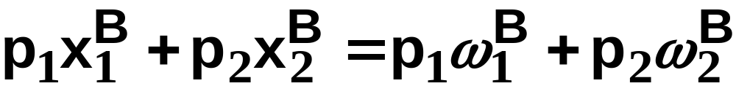
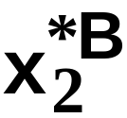
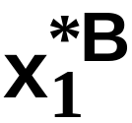
Trade in Competitive Markets
For consumer B.
O_{B}

Slide 59
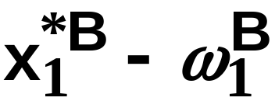
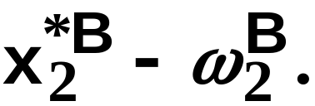
Trade in Competitive Markets
So given p₁ and p₂, consumer B’s net demands for commodities 1 and 2 are
and

Slide 60
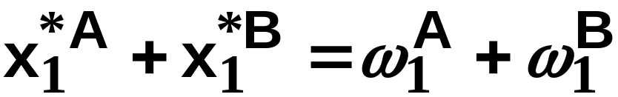
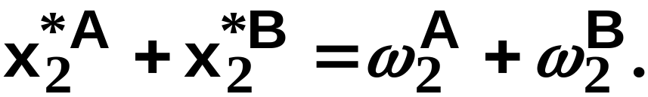
Trade in Competitive Markets
A general equilibrium occurs when prices p₁ and p₂ cause both the markets for commodities 1 and 2 to clear; i.e.
and

Slide 61
Trade in Competitive Markets
O_{B}
O_{A}

Slide 62
Trade in Competitive Markets
Can this PO allocation be
achieved?
O_{B}
O_{A}

Slide 63
Trade in Competitive Markets
Budget constraint for consumer A
O_{B}
O_{A}

Slide 64
Trade in Competitive Markets
Budget constraint for consumer A
O_{B}
O_{A}

Slide 65
Trade in Competitive Markets
O_{B}
O_{A}
Budget constraint for consumer B

Slide 66
Trade in Competitive Markets
O_{B}
O_{A}
Budget constraint for consumer B

Slide 67
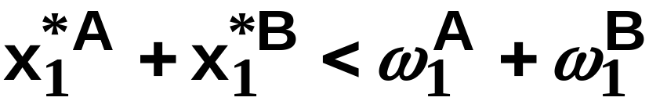
Trade in Competitive Markets
O_{B}
O_{A}
But

Slide 68
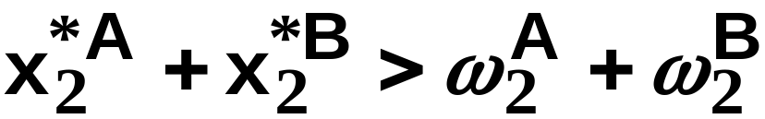
Trade in Competitive Markets
O_{B}
O_{A}
and

Slide 69
Trade in Competitive Markets
So at the given prices p₁ and p₂ there is an
  excess supply of commodity 1
  excess demand for commodity 2.
Neither market clears so the prices p₁ and p₂ do not cause a general equilibrium.

Slide 70
Trade in Competitive Markets
So this PO allocation cannot be
achieved by competitive trading.
O_{B}
O_{A}

Slide 71
Trade in Competitive Markets
Which PO allocations can be
achieved by competitive trading?
O_{B}
O_{A}

Slide 72
Trade in Competitive Markets
Since there is an excess demand for commodity 2, p₂ will rise.
Since there is an excess supply of commodity 1, p₁ will fall.
The slope of the budget constraints is - p₁/p₂ so the budget constraints will pivot about the endowment point and become less steep.

Slide 73
Trade in Competitive Markets
Which PO allocations can be
achieved by competitive trading?
O_{B}
O_{A}

Slide 74
Trade in Competitive Markets
Which PO allocations can be
achieved by competitive trading?
O_{B}
O_{A}

Slide 75
Trade in Competitive Markets
Which PO allocations can be
achieved by competitive trading?
O_{B}
O_{A}

Slide 76
Trade in Competitive Markets
Budget constraint for consumer A
O_{B}
O_{A}

Slide 77
Trade in Competitive Markets
Budget constraint for consumer A
O_{B}
O_{A}

Slide 78
Trade in Competitive Markets
O_{B}
O_{A}
Budget constraint for consumer B

Slide 79
Trade in Competitive Markets
O_{B}
O_{A}
Budget constraint for consumer B

Slide 80

Trade in Competitive Markets
O_{B}
O_{A}
So

Slide 81
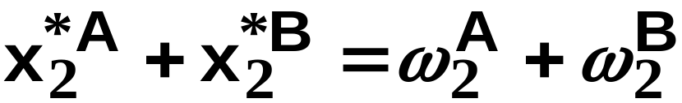
Trade in Competitive Markets
O_{B}
O_{A}
and

Slide 82
Trade in Competitive Markets
At the new prices p₁ and p₂ both markets clear; there is a general equilibrium.
Question 1: Are prices p₁ and p₂ determined independently at equilibrium?
Question 2: Does the equilibrium exist?

Slide 83
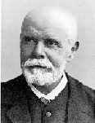
Walras’ Law (瓦尔拉斯法则)
Walras’ Law is an identity; i.e. a statement that is true for any positive prices (p₁,p₂), whether these are equilibrium prices or not.
1834-1910

Slide 84
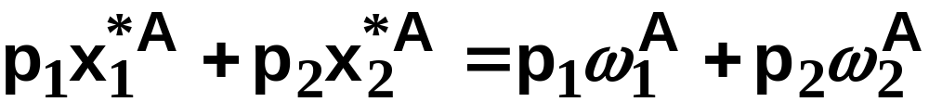
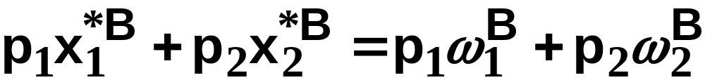
Walras’ Law
Every consumer’s preferences are well-behaved so, for any positive prices (p₁,p₂), each consumer spends all of his budget.
For consumer A:
For consumer B:

Slide 85
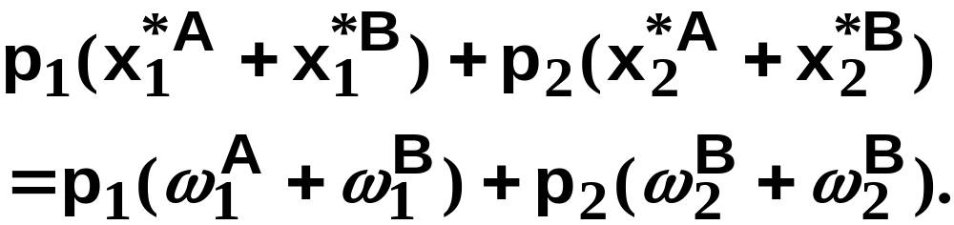
Walras’ Law
Summing gives

Slide 86
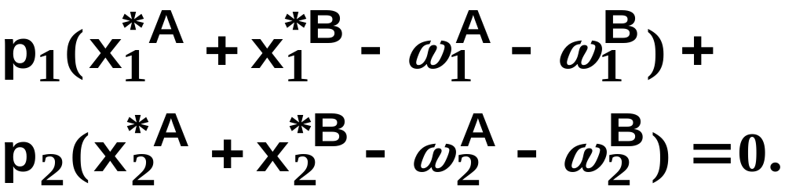
Walras’ Law
Rearranged,
That is, ...

Slide 87
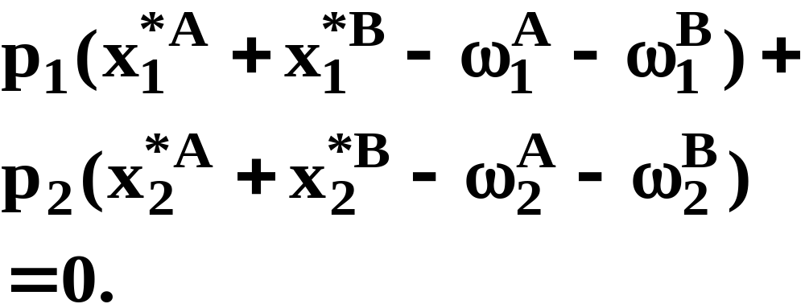
Walras’ Law
This says that the summed market
value of excess demands is zero for
any positive prices p₁ and p₂ --
this is Walras’ Law.

Slide 88
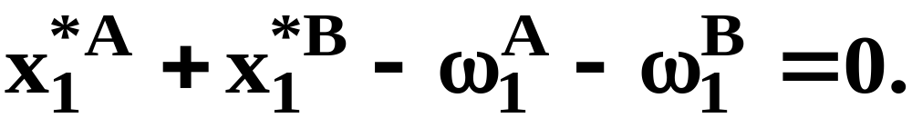


Implications of Walras’ Law
Suppose the market for commodity A
is in equilibrium; that is,
Then
implies

Slide 89
Implications of Walras’ Law
So one implication of Walras’ Law for a two-commodity exchange economy is that if one market is in equilibrium then the other market must also be in equilibrium.
In general, if there are k markets, then only k-1 prices are determined at equilibrium.
I.e., the general equilibrium determines only relative prices.

Slide 90


Implications of Walras’ Law
What if, for some positive prices p₁ and
p₂, there is an excess quantity supplied
of commodity 1? That is,
Then
implies

Slide 91
Implications of Walras’ Law
So a second implication of Walras’ Law
for a two-commodity exchange economy
is that an excess supply in one market
implies an excess demand in the other
market.

Slide 92
Solve for General Equilibrium
Individual optimization problem
X_{i}=X_{i} (P₁,P₂,M_{i}), i=1,2
M_{i}=M_{i} (P₁,P₂,ω_{Xi} , ω_{Yi})
X_{i}=X_{i} (P₁,P₂ )
Market clearing for market X:
X₁ (P₁,P₂)+ X₂ (P₁,P₂) = ω_{X1} + ω_{X2}
Similarly, for market Y
Y₁ (P₁,P₂)+ Y₂ (P₁,P₂) = ω_{Y1} + ω_{Y2}

Slide 93
Solve for General Equilibrium
If we find some equilibrium set of prices (P₁,P₂ ), then (tP₁,tP₂ ) are equilibrium prices as well, for any t>0
This means what matters is the relative price. We can set one price equal to 1, all the other prices are being measured relative to it.
Can solve for equilibrium P₁/P₂

Slide 94
Existence of Equilibrium
Require that the aggregate excess demand functions be a continuous function, which in turn require that
  Each individual’s demand function be continuous, or
  Each consumer is small relative to the market.

Slide 95
Trade in Competitive Markets
Trading in competitive markets achieves a particular Pareto-optimal allocation of the endowments.
This is an example of the First Fundamental Theorem of Welfare Economics.

Slide 96
First Fundamental Theorem of Welfare Economics
Given that consumers’ preferences are well-behaved, trading in perfectly competitive markets implements a Pareto-optimal allocation of the economy’s endowment.

Slide 97
Implicit Assumptions
No consumption externality (外部效应)
Agents behave competitively
Equilibrium exists

Slide 98
Second Fundamental Theorem of Welfare Economics
The First Theorem is followed by a second that states that any Pareto-optimal allocation (i.e. any point on the contract curve) can be achieved by trading in competitive markets provided that endowments are first appropriately rearranged amongst the consumers.

Slide 99
Second Fundamental Theorem of Welfare Economics
Given that consumers’ preferences are well-behaved, for any Pareto-optimal allocation there are prices and an allocation of the total endowment that makes the Pareto-optimal allocation implementable by trading in competitive markets.

Slide 100
Second Fundamental Theorem
O_{B}
O_{A}
The contract curve

Slide 101




Second Fundamental Theorem
O_{B}
O_{A}

Slide 102
Second Fundamental Theorem
Implemented by competitive
trading from the endowment ω.
O_{B}
O_{A}

Slide 103
Second Fundamental Theorem
Can this allocation be implemented
by competitive trading from ω?
O_{B}
O_{A}

Slide 104
Second Fundamental Theorem
Can this allocation be implemented
by competitive trading from ω? No.
O_{B}
O_{A}

Slide 105




Second Fundamental Theorem
But this allocation is implemented
by competitive trading from θ.
O_{B}
O_{A}

Slide 106

The Assumption about Convexity

